Slide 1


Java Fundamentals Loops
CMPS 251
Read Chapters 2, 4 and 5
Unit 1_04

Slide 2
Outline
Increment/decrement operators
while loop
do-while loop
for loop
break statement
continue statement

Slide 3

Java Loops

Slide 4
The Increment and Decrement Operators
In programming (Java, C, C++, JavaScript etc. ), the increment operator ++ increases the value of a variable by 1. Similarly, the decrement operator -- decreases the value of a variable by 1.
int a=10, b = 5 , c = 6;
a++;
b--;
c++;
System.out.printf("a=%d , b=%d , c=%d %n" , a, b , c);
//Output => a=11 , b=4 , c=7

Slide 5
The Increment and Decrement Operators
++ and -- operator as prefix and postfix
If you use the ++ operator as prefix like: ++var. The value of var is first incremented by 1 then, it returns the value.
If you use the ++ operator as postfix like: var++. The original value of var is returned first then, var is incremented by 1.
The -- operator works in a similar way like the ++ operator except it decreases the value by 1.
int a=10, b = 5 , c = 6 , d , e;
d=a++; // d=a first (10) then a is incremented by 1 a = 11
c=--b; // b is decremented first then c=b (both = 5)
b=++a; // a is incremented first then b=a (both = 12)
e = --b + a-- ; //b is decremented first (11) then e = 11 + 12 then a is decremented
System.out.printf("a=%d , b=%d , c=%d , d=%d e=%d %n" , a, b , c , d , e);
//Output a=11 , b=11 , c=4 , d=10 e=23

Slide 6
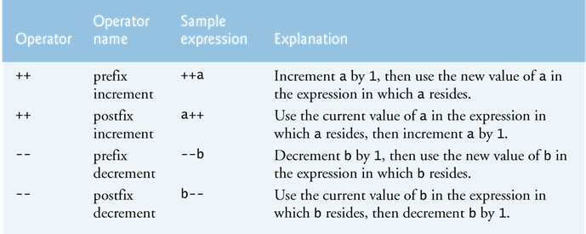
The Increment and Decrement Operators

Slide 7
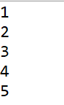
The while Loop
While the condition is true, the statements will execute repeatedly.
The while loop is a pretest loop, which means that it will test the value of the condition prior to executing the loop.
int i = 1;
while ( i <= 5) { // condition
System.out.println(i);
i++; // increment
}
while(condition)
{
statements;
}
boolean
expression?
true
statement(s)
false

Slide 8
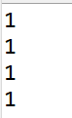
Infinite Loop
In order for a while loop to end, the condition must become false. The following loop will never end:
int i = 1;
while ( i <= 5) { // condition will never become false 1 =1
System.out.println(i);
}
... forever
A while loop executes 0 or more times. If the initial condition is false, the loop will not execute.
int i = 10;
while ( i <= 5) { // initial condition is false. Loop body skipped
System.out.println(i);
} // No output. Loop never executed

Slide 9
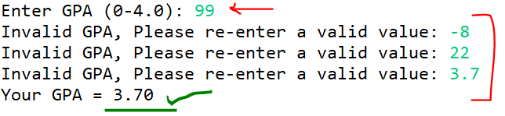
The while Loop for Input Validation
Input validation is the process of ensuring that user input is valid.
double gpa;
Scanner input = new Scanner(System.in);
System.out.print("Enter GPA (0-4.0): ");
gpa = input.nextDouble();
while ( gpa > 4 || gpa < 0) {//Validate the input
System.out.print("Invalid GPA, Please re-enter a valid value: ");
gpa = input.nextDouble();
// Keep getting until a valid value is entered
}
System.out.printf("Your GPA = %.2f %n", gpa);

Slide 10
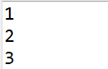
The do-while Loop
The do-while loop is a post-test loop, which means it will execute the loop prior to testing the condition.
do
{
statement(s);
}while (condition);
int i =1;
do {
System.out.println(i);
i++;
}while (i <= 3);
statement(s)
boolean
expression?
true
false

Slide 11
The do-while Loop
The do-while loop executes at least once since the condition is tested at the bottom of the loop.
int i =99;
do { //Loop executed once
System.out.println(i);
i++;
}while (i <= 3); //Condition is found false here
//Outputs 99 once

Slide 12
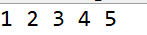
The for Loop
A pre-test loop. The for loop allows the programmer to initialize a control variable, test a condition, and modify the control variable all in one line of code.
for(initialization; test; update)
{
statement(s);
}
boolean
expression?
true
statement(s)
update
int i; // Loop control variable
for (i = 1; i <= 5; i++)
{
System.out.print(i +" ");
}
false

Slide 13
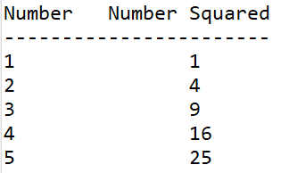
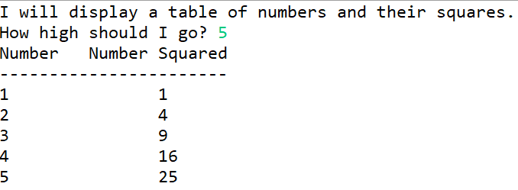
The for Loop
int number; // Loop control variable
System.out.println("Number Number Squared");
System.out.println("-----------------------");
for (number = 1; number <= 5; number++)
{
System.out.println(number + "\t\t"
+number * number);
}
int number; // Loop control variable
int maxValue; // Maximum value to display
System.out.println("I will display a table of " +
"numbers and their squares.");
Scanner keyboard = new Scanner(System.in);
System.out.print("How high should I go? ");
maxValue = keyboard.nextInt();
System.out.println("Number Number Squared");
System.out.println("-----------------------");
for (number = 1; number <= maxValue; number++)
{
System.out.println(number + "\t\t" + number * number);
}

Slide 14
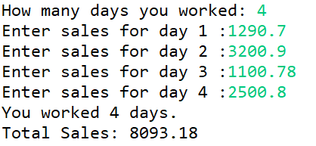
The for Loop : Total Sales
int days;
double daySale, totalSales=0;
Scanner keyboard = new Scanner(System.in);
System.out.print("How many days you worked: ");
days = keyboard.nextInt();
for (int i=1; i <=days ;i++) {
System.out.printf("Enter sales for day %d :" , i);
daySale = keyboard.nextDouble();
totalSales +=daySale;
}
System.out.printf("You worked %d days.%n" , days );
System.out.printf("Total Sales: %.2f " , totalSales );
keyboard.close();

Slide 15
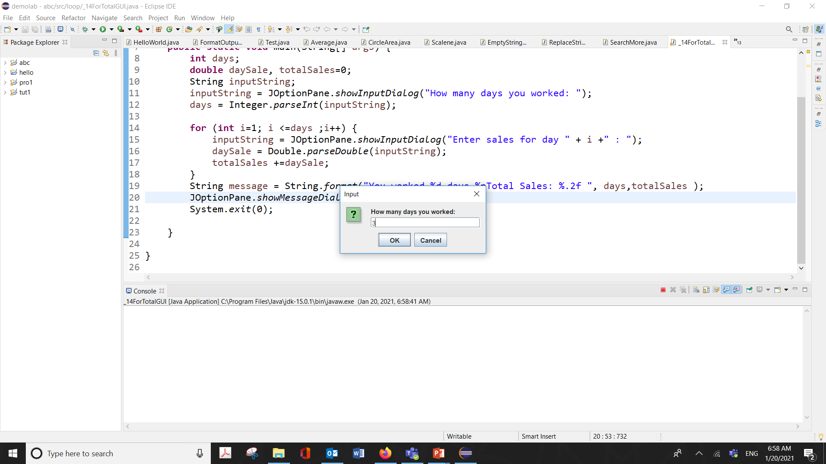
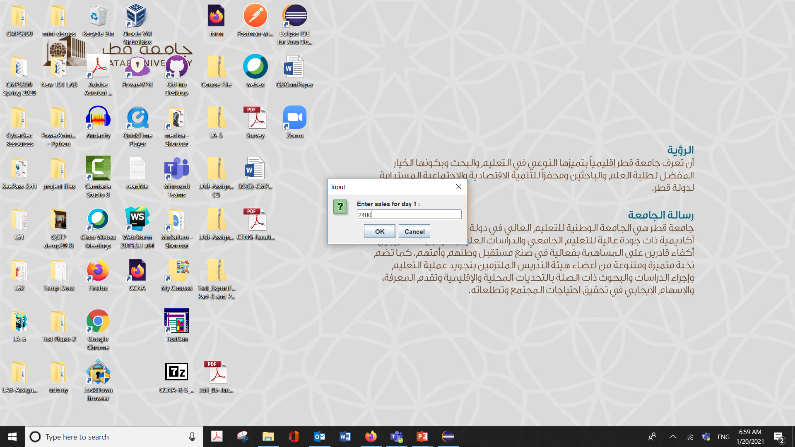


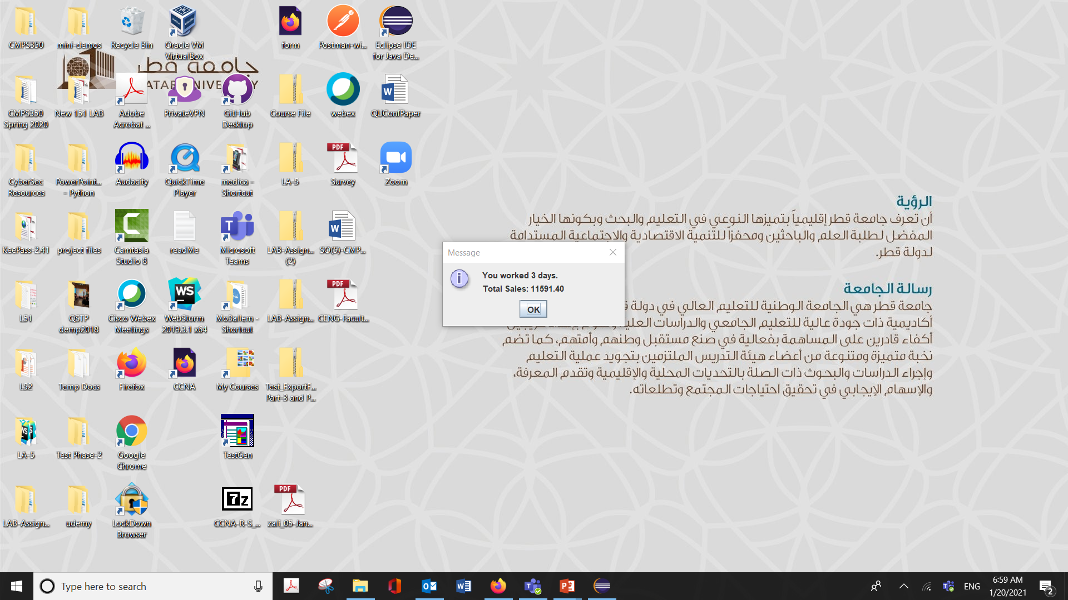
The for Loop : Total Sales with Dialog Boxes
int days;
double daySale, totalSales=0;
String inputString;
inputString = JOptionPane.showInputDialog
("How many days you worked: ");
days = Integer.parseInt(inputString);
for (int i=1; i <=days ;i++) {
inputString = JOptionPane.showInputDialog
("Enter sales for day " + i +" : ");
daySale = Double.parseDouble(inputString);
totalSales +=daySale;
}
String message = String.format("You worked %d days.%nTotal Sales: %.2f “
, days,totalSales );
JOptionPane.showMessageDialog(null,message);
System.exit(0);

Slide 16
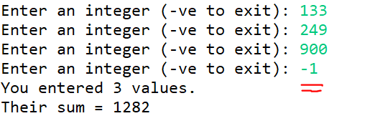
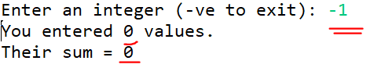
Sentinel Values
Sometimes the end point of input data is not known.
A sentinel value can be used to notify the program to stop acquiring input.
The user could be prompted to input data that is not normally in the input data range (i.e. –1 where normal input would be positive.)
int value, sum=0, count=0;
Scanner keyboard = new Scanner(System.in);
System.out.print("Enter an integer (-ve to exit): ");
value = keyboard.nextInt();
while ( value >= 0) {
sum += value;
count++;
System.out.print("Enter an integer (-ve to exit): ");
value = keyboard.nextInt();
}
System.out.printf("You entered %d values.%n" , count );
System.out.printf("Their sum = %d " , sum );
keyboard.close();

Slide 17
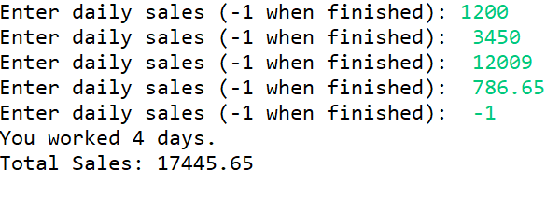
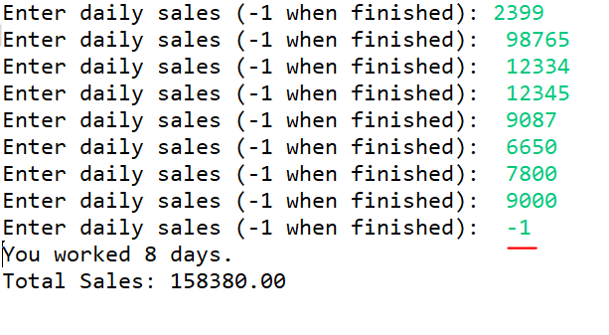
Sentinel Values : Total Sales
int days=0;
double daySale, totalSales=0;
Scanner keyboard = new Scanner(System.in);
System.out.print("Enter daily sales (-1 when finished): ");
daySale = keyboard.nextDouble();
// Accumulate the sales until -1 is entered.
while (daySale != -1)
{
days++;// Increment days
totalSales += daySale; //Accumulate sales
// Get the next daily sales .
System.out.print("Enter daily sales (-1 when finished): ");
daySale = keyboard.nextDouble();
}
// Display the total Sales and number of days
System.out.printf("You worked %d days.%n" , days );
System.out.printf("Total Sales: %.2f " , totalSales );
keyboard.close();

Slide 18
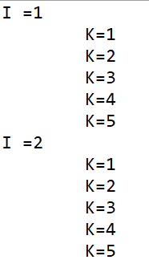
Nested Loops
Like if statements, loops can be nested.
If a loop is nested, the inner loop will execute all of its iterations for each time the outer loop executes once. The loop statements in this example will execute 100 times.
for(int i = 0; i < 10; i++)
for(int j = 0; j < 10; j++)
loop statements;
for (int i=1; i <3 ; i++)
{
System.out.println("I ="+ i);
for (int k=1; k<=5; k++)
System.out.println("\tK=" + k);
}

Slide 19
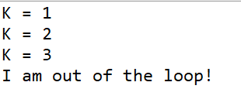
The break Statement
The break statement can be used to abnormally terminate a loop.
The use of the break statement in loops bypasses the normal mechanisms and makes the code hard to read and maintain.
It is considered bad form to use the break statement in this manner.
int k=1;
while ( k < 10) {
System.out.println("K = " + k);
k++;
if ( k % 4 == 0)
break;
}
System.out.println("I am out of the loop!");

Slide 20
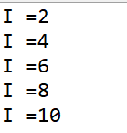
The continue Statement
The continue statement will cause the currently executing iteration of a loop to terminate and the next iteration will begin.
The continue statement will cause the evaluation of the condition in while and for loops.
Like the break statement, the continue statement should be avoided because it makes the code hard to read and debug.
for (int i=1; i <= 10 ; i++)
{
if (i % 2 ==1)
continue;
System.out.println("I ="+ i);
}

